Slide 1

TROLL ULTRASONIC R&D
- Confidential -
Project period: -> Jan 2019
Pre-testing: June - Aug 2017
Main testing: Sept/Okt 2017 – Nov 2018
Industry partner: Lerøy Seafood, Lerøy Midt AS
Funding: The Norwegian Research Council

Slide 2
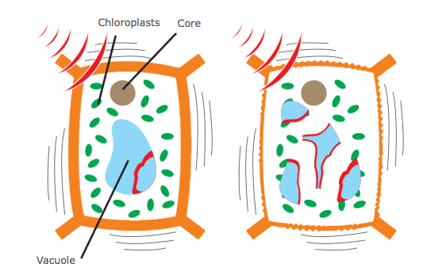
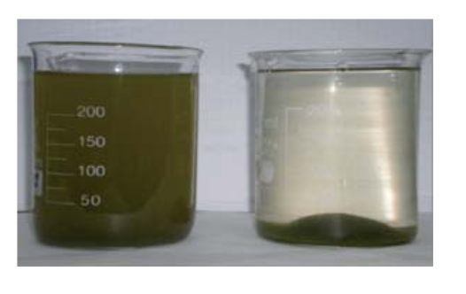
Goal and function
Main goal
  Disrupt biofouling in the first and second growth phase. This means to either prevent the bacterial or conditioning layer to settle on fish farming nets.

Slide 3
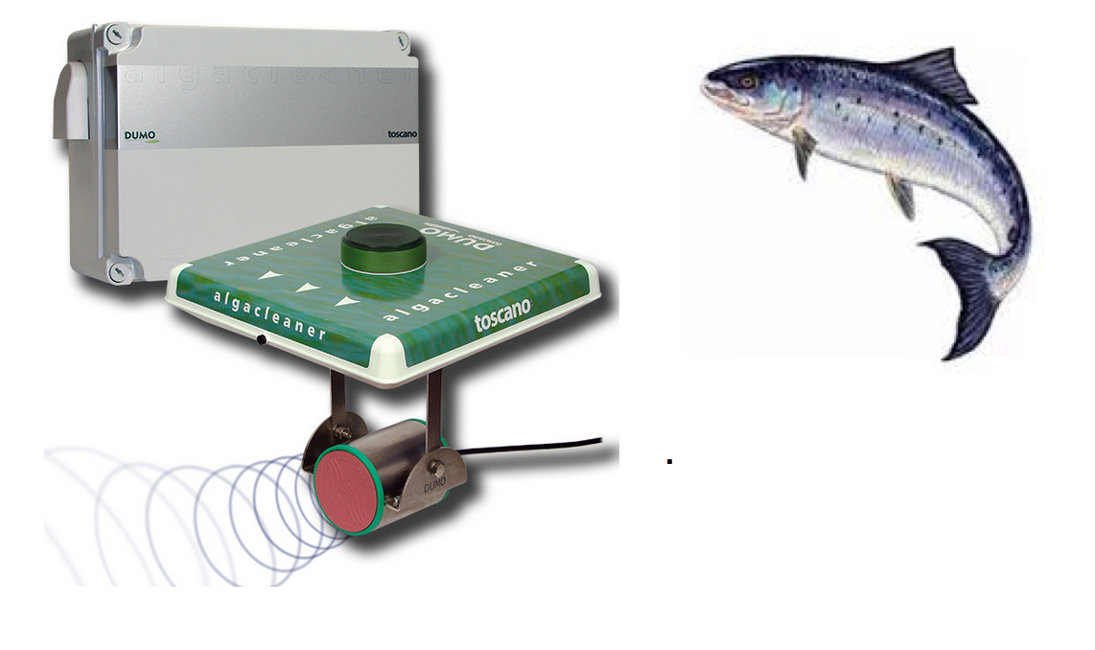
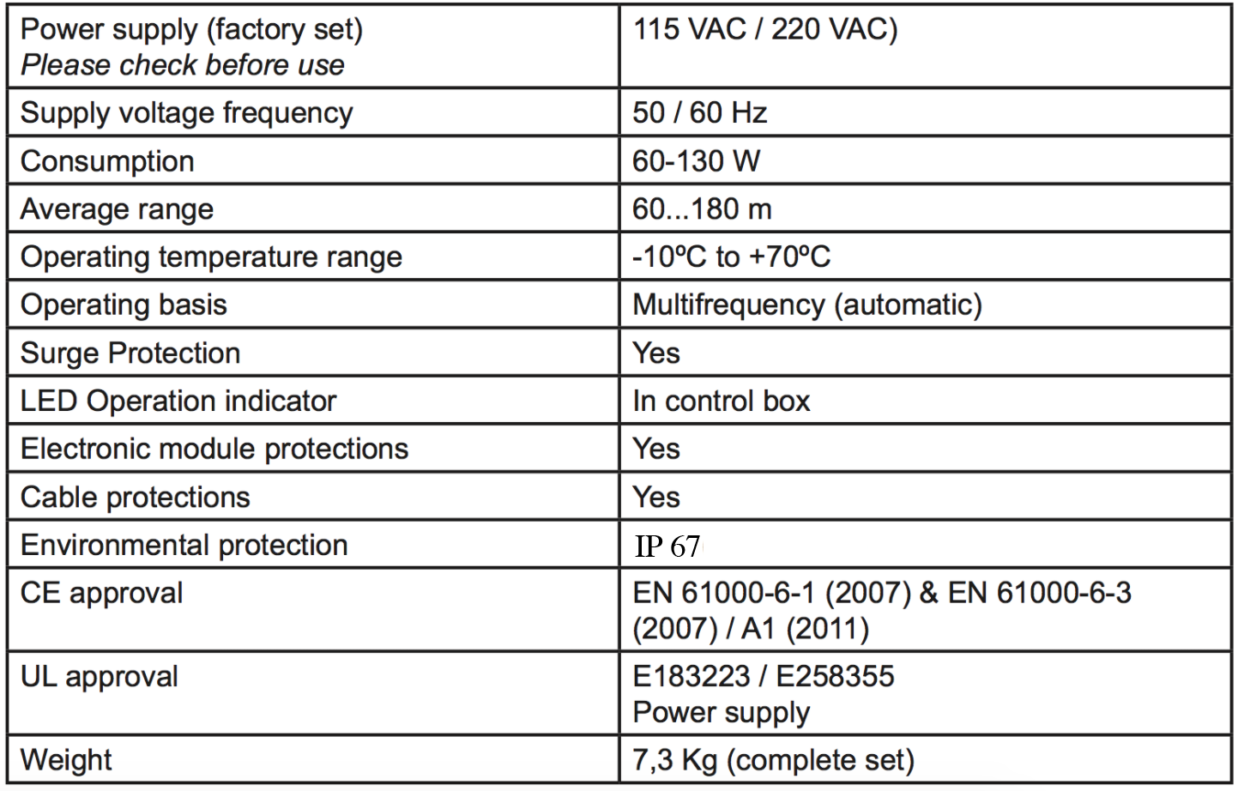
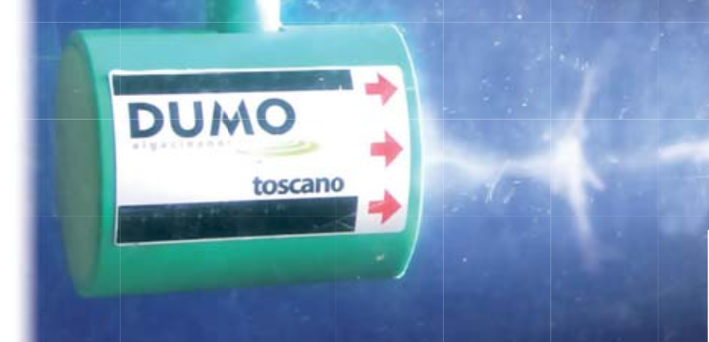
Pre-test: Applied technology

Slide 4
General data
Fish net diameter/radius: 157 m / 59 m
Fish net depth: 15 m (vertical) + 10 m (angled)
Depth of sea bed: Below test net 70 m. Below reference net 90 m.
Fixing of transducers for pre-test: 0,5-1 m under sea level and 2 m from fish net. Placed centered and below the fish cage floating tubes.
Signalfrequency for pre-test: 20 til 50 kHz swipe and in addition focus on spesific frequencies. These frequencies are to be provided.
Dumo transducer spred angle: 168 degrees

Slide 5
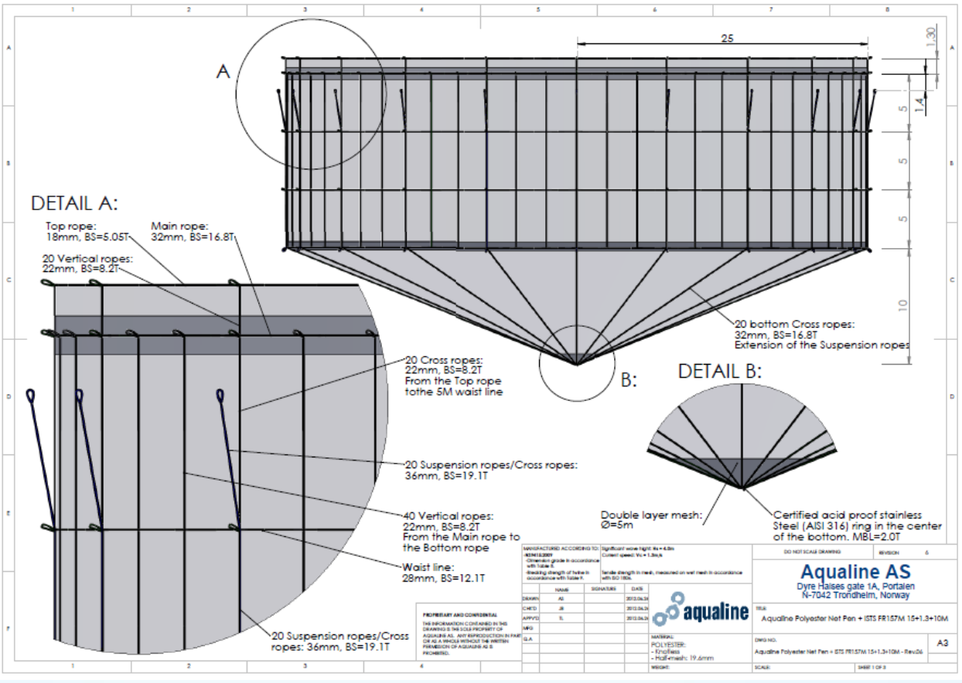

Slide 6
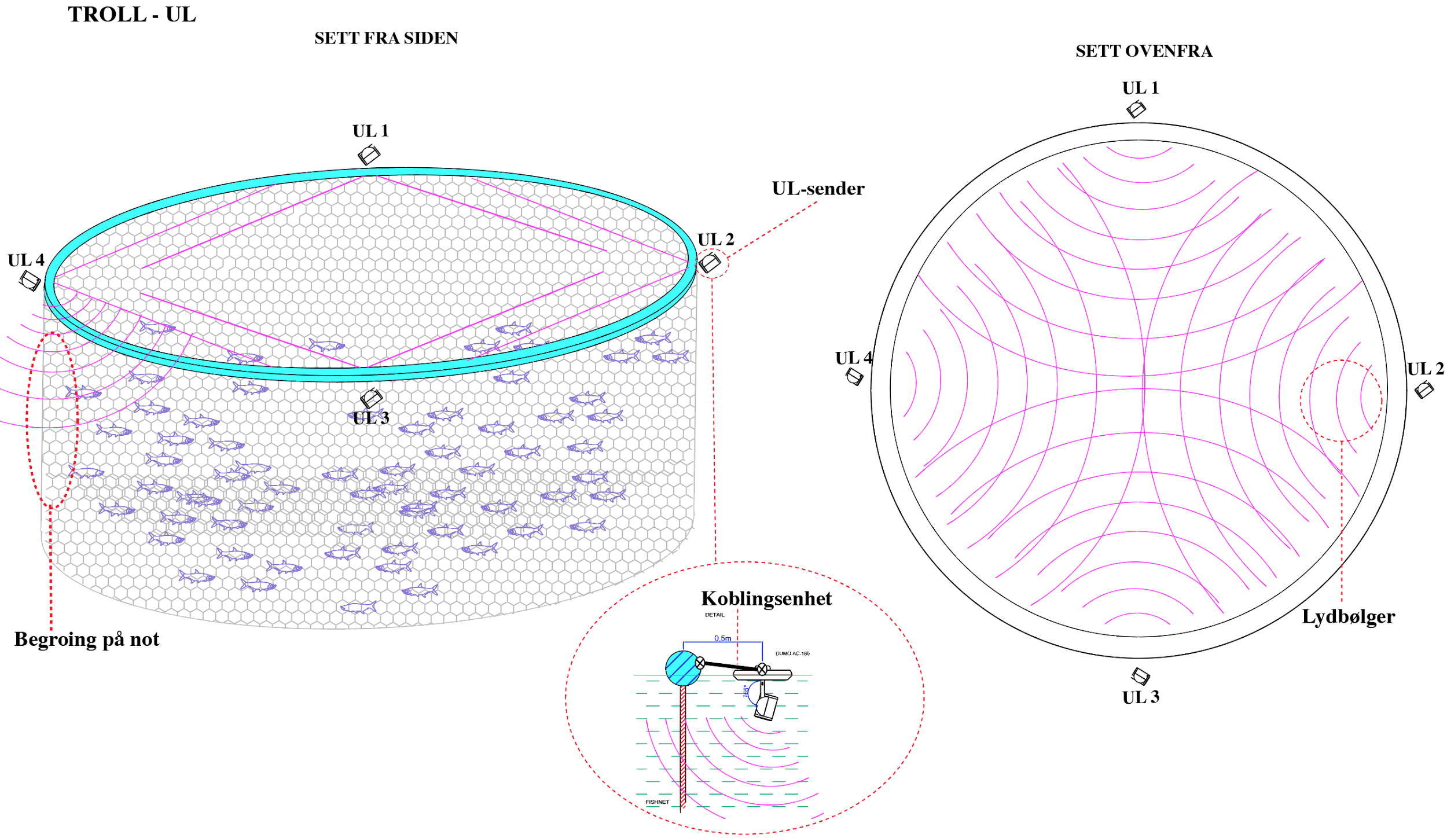
Pre-test system

Slide 7
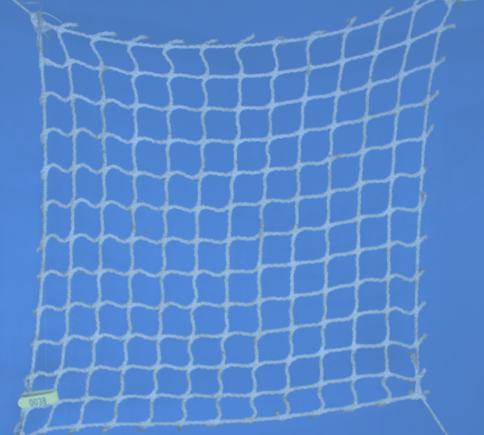
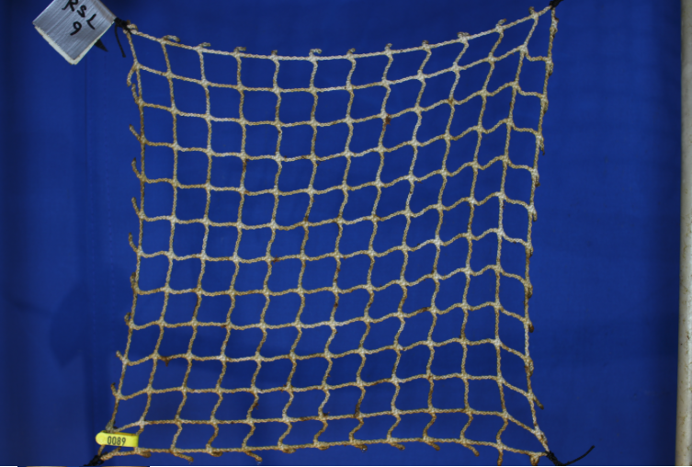
Results after 1 month pre-test
Test fish net
Reference fish net
The left net is from the test without ultrasound.
The right net is from the test with ultrasound.
The backrground color changed in the copy prosess, but the biofouling colouring of the net is visible.

Slide 8
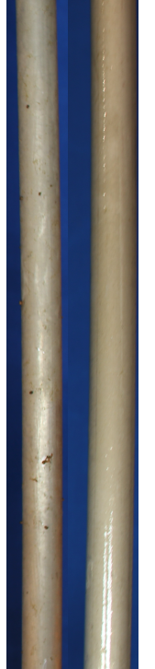
Results after 1 month pre-test (metal rods)
The top rod is part of the frame for the reference net without ultrasound. Tiny shells have attached to the non-ultrasound area.
The bottom rod is part of the frame for the test net with ultrasound.

Slide 9
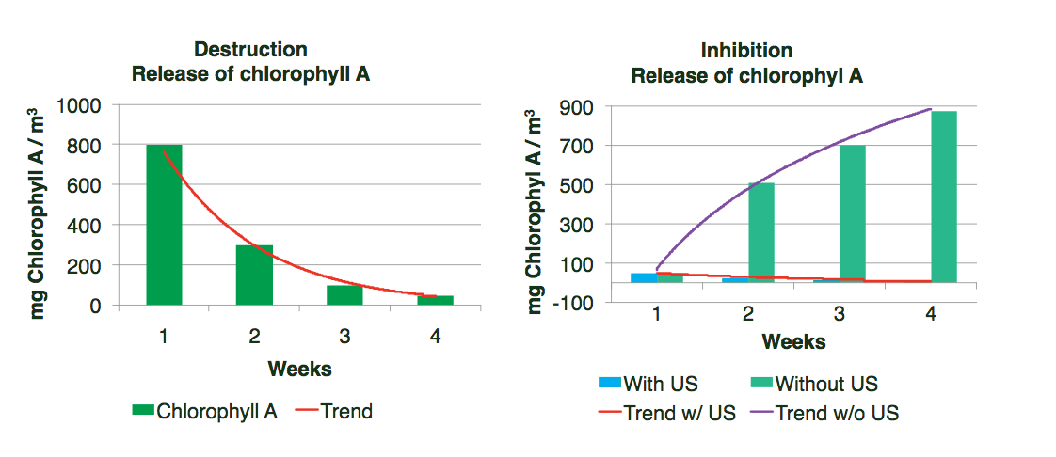
Popolar visualization of effectivness of the Dumo-system

Slide 10
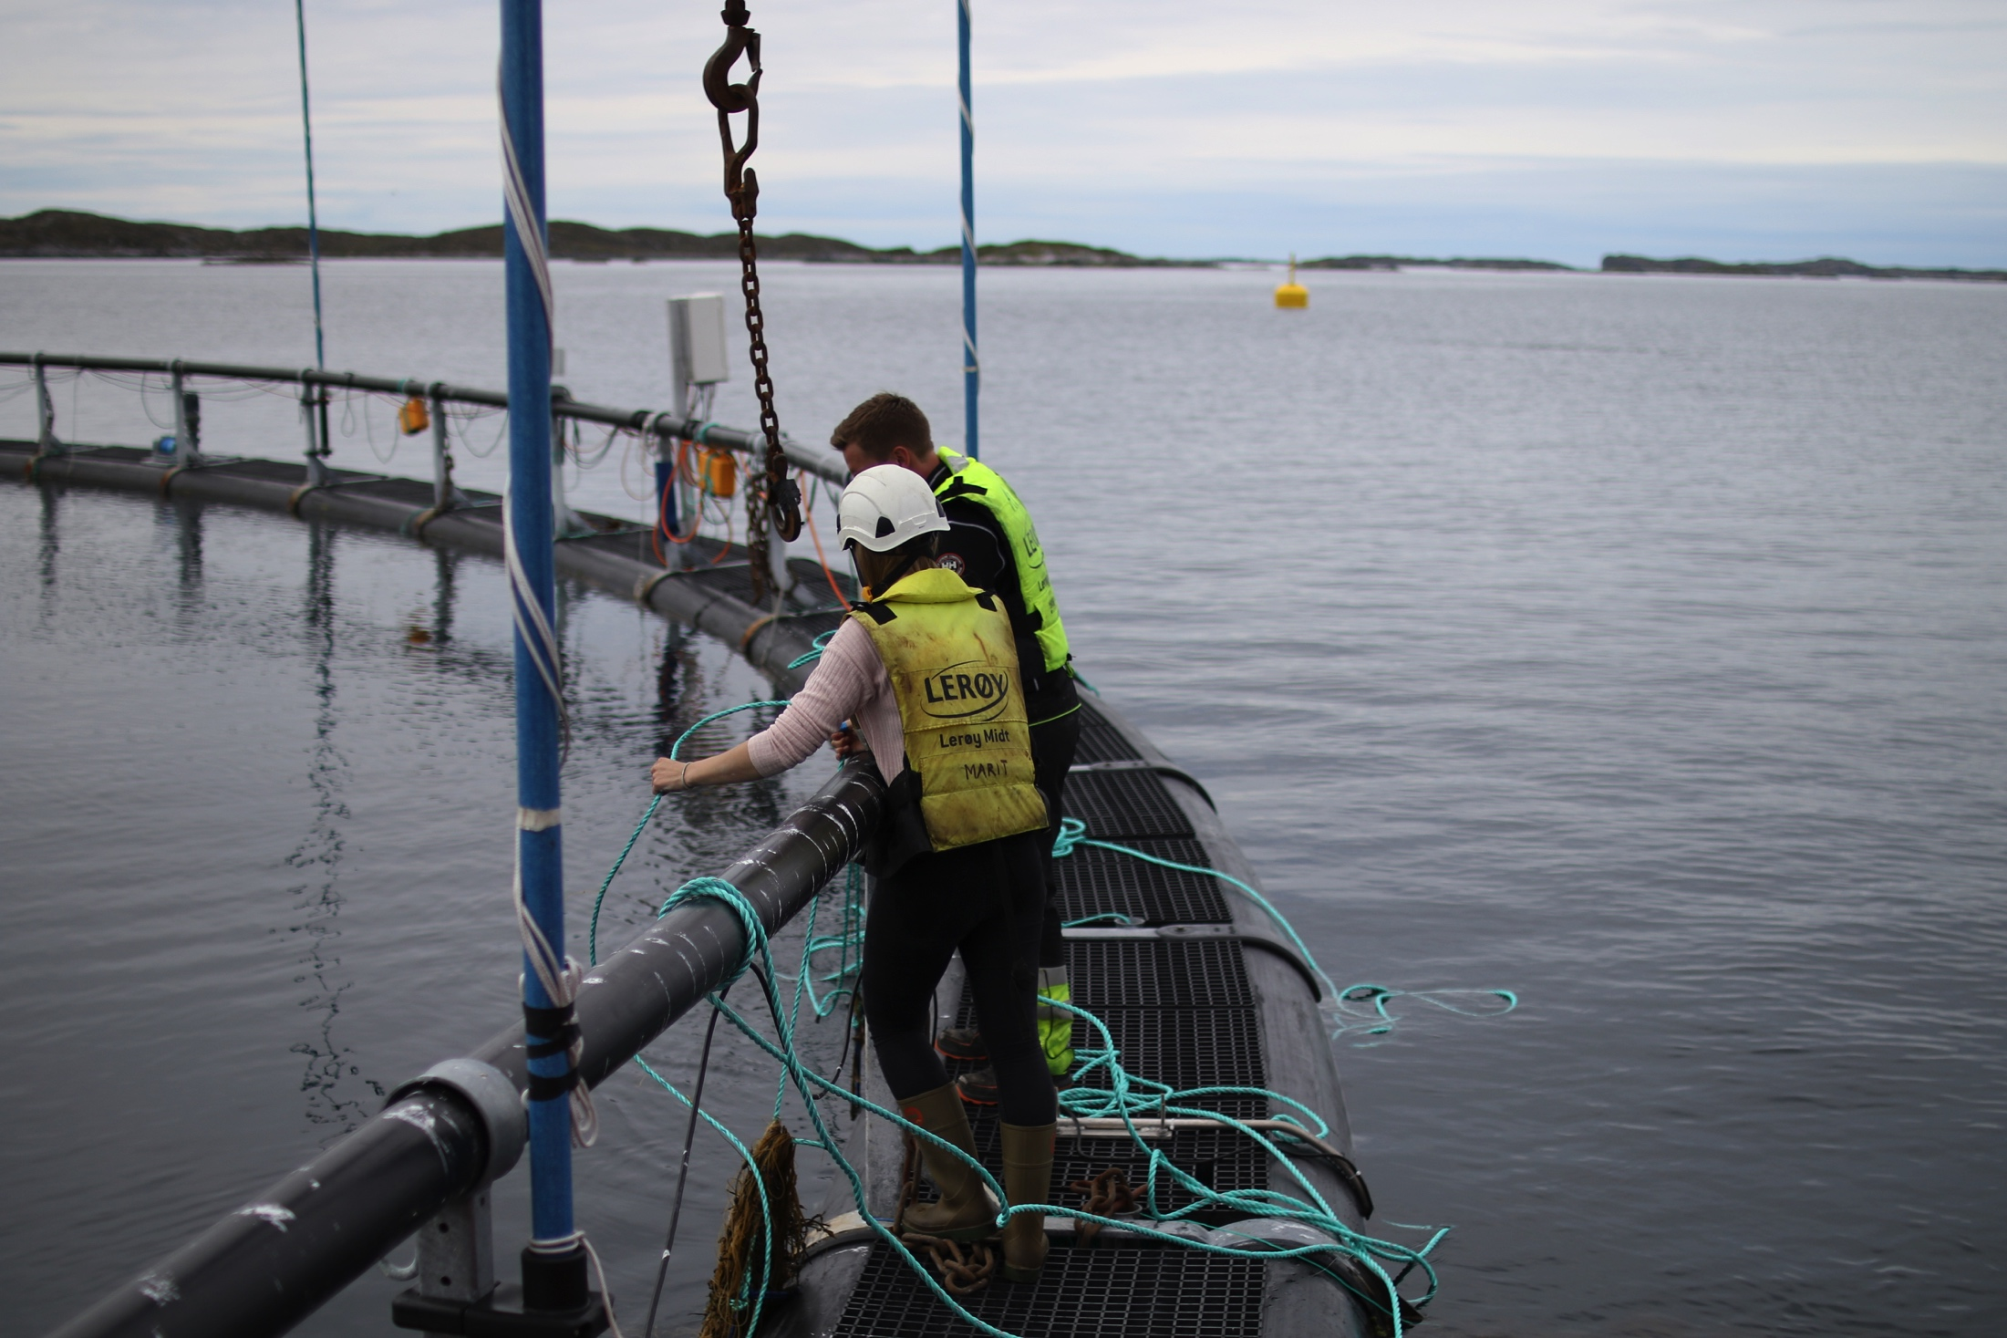
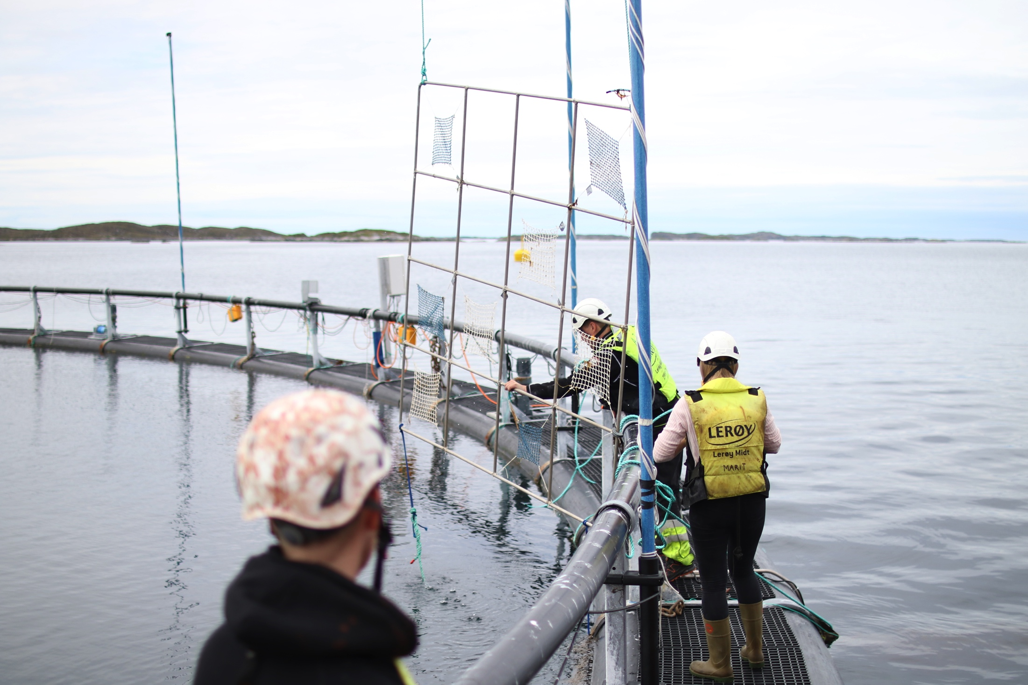
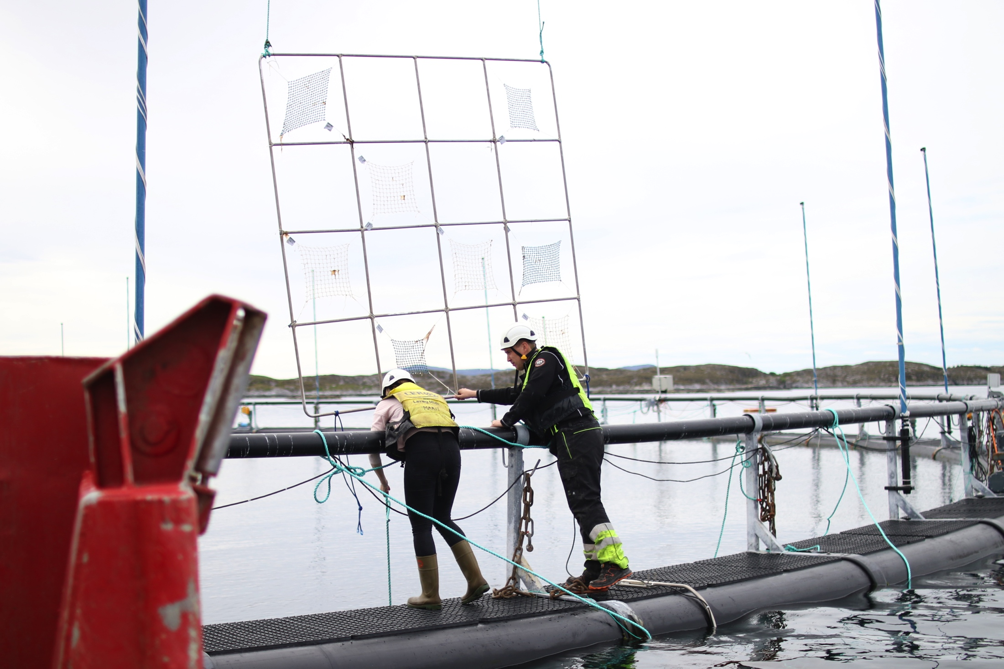
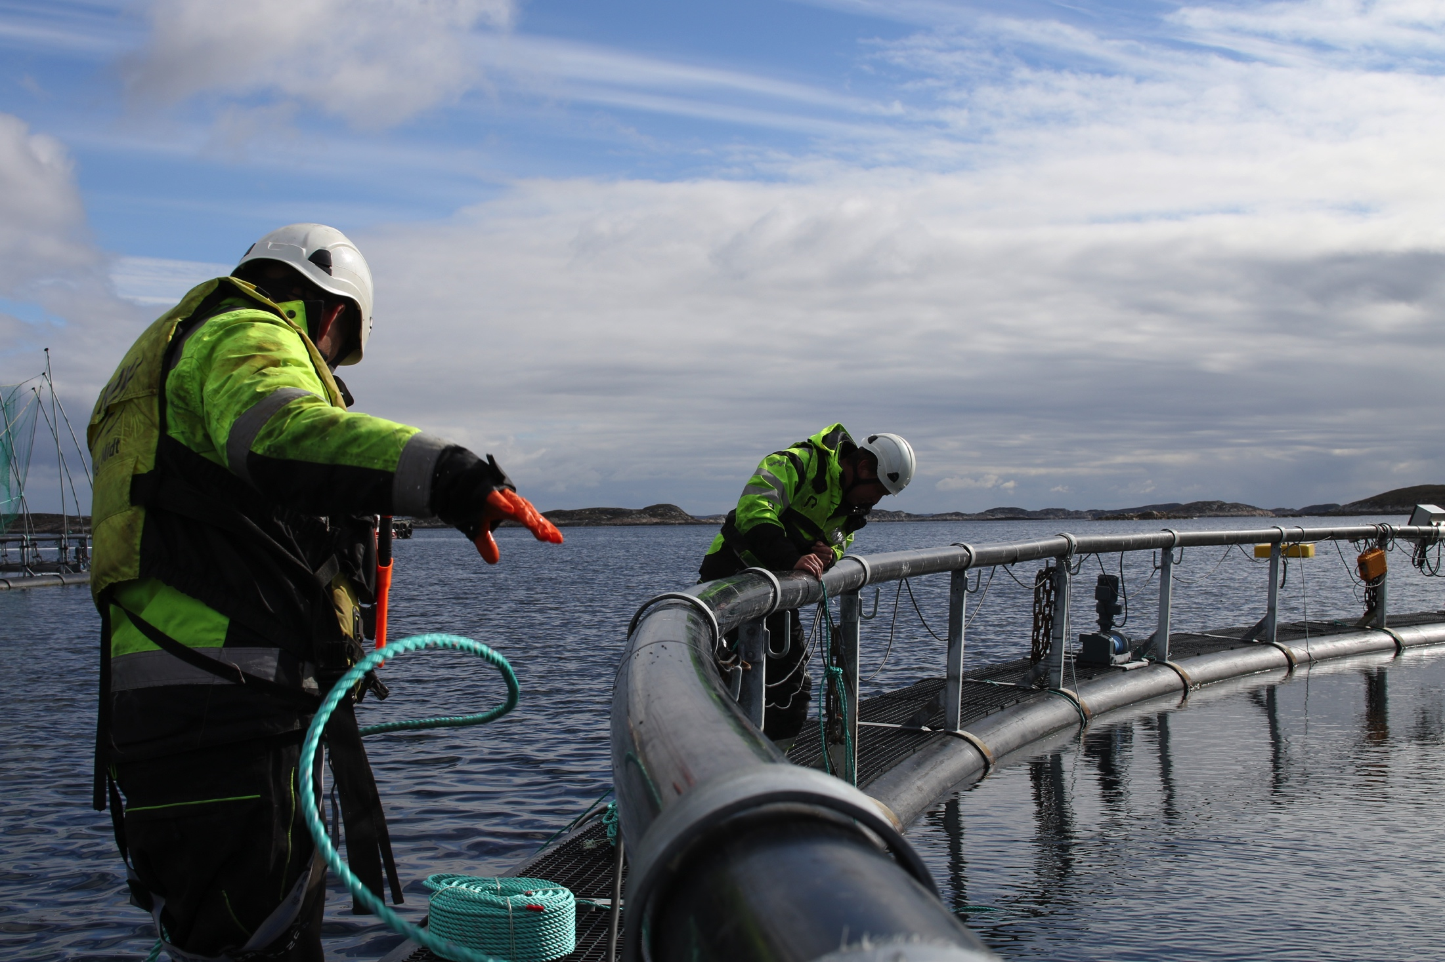
Pre-test pics

Slide 11
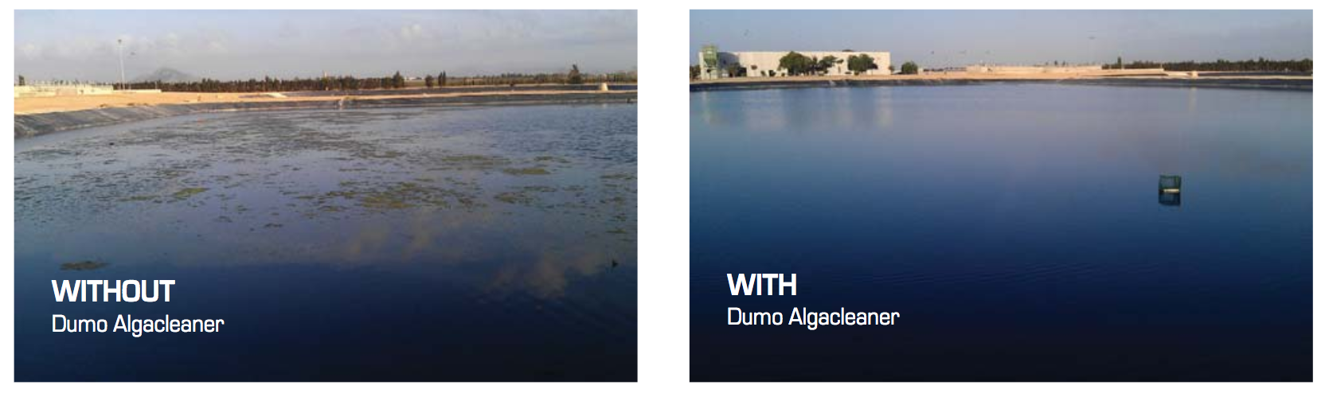
Algae prevention in still water (Dumo)

Slide 12
Troll-project organization
NOCS
Norwegian Ocean Cleaning Systems
Project manager
WP 2 BIOFOULING
Photographic sampling. Binary computer analysis
WP 4 Sorroundings
Normal reporting. Detect changes.
WP 3 Fish behaviour and wellfare
Film in fish net. Visual data
WP 1 Ultrasound
Design. Innovation. Lab and on-site testing and calibration.
Sintef Ocean
R&D
W5 4 LICE
Standard counting and reporting. Analysis of potential deviations.
Lerøy Seafood (Lerøy Midt AS)
Industry partner

Slide 13
Lab/on-site ultrasonic equipment
Sintef Ocean will use 3 tubs:
  The tubs are octagonal
  The short sides are 50 cm and the long sides are 125 cm
  Dimentions: 2x2x0,9 meters
  Volume: 3,6 m3
Preliminary data for the budget proposal (+- 40 %)
  Three generators. MMM to be included?
  Three tubular transducers. Transducer design suggestions to be viewed in the meeting at MPI facilities. Preparations needed.
  R&D support?
  Other

Slide 14
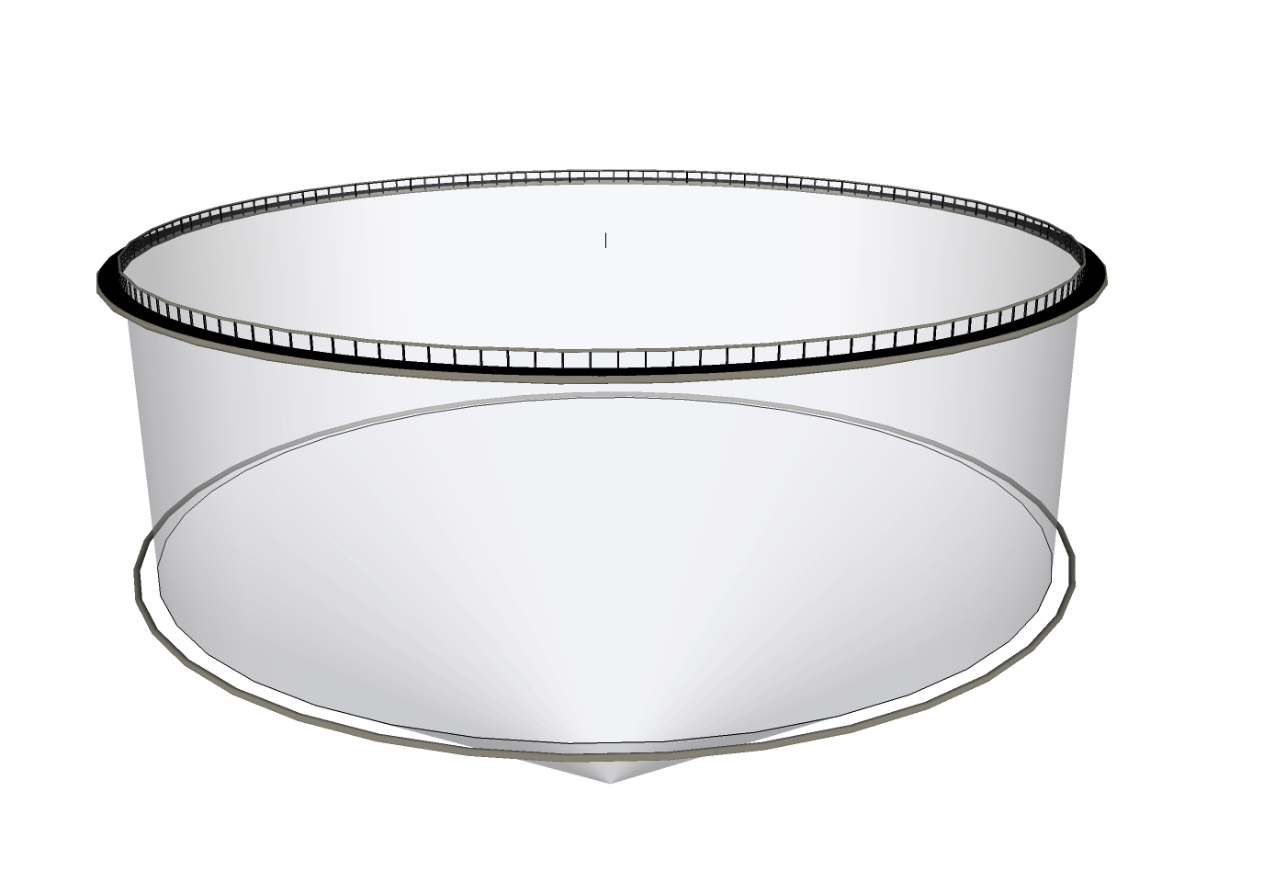
Fish net and cage sketch

Slide 15
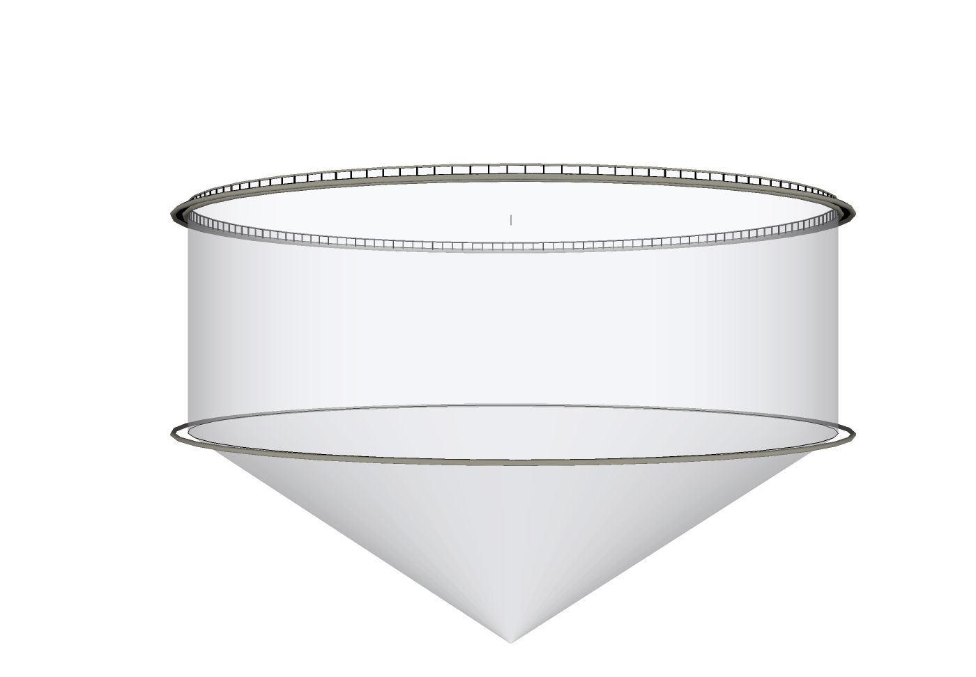
Fish net and cage sketch

Slide 16
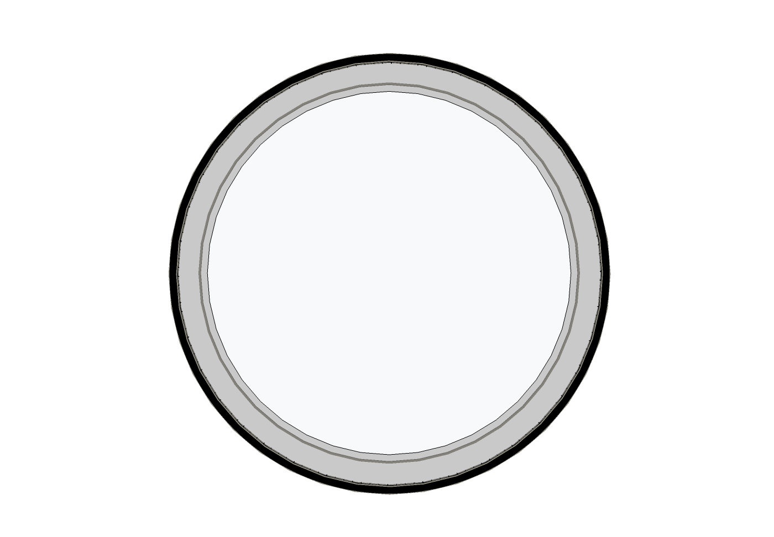
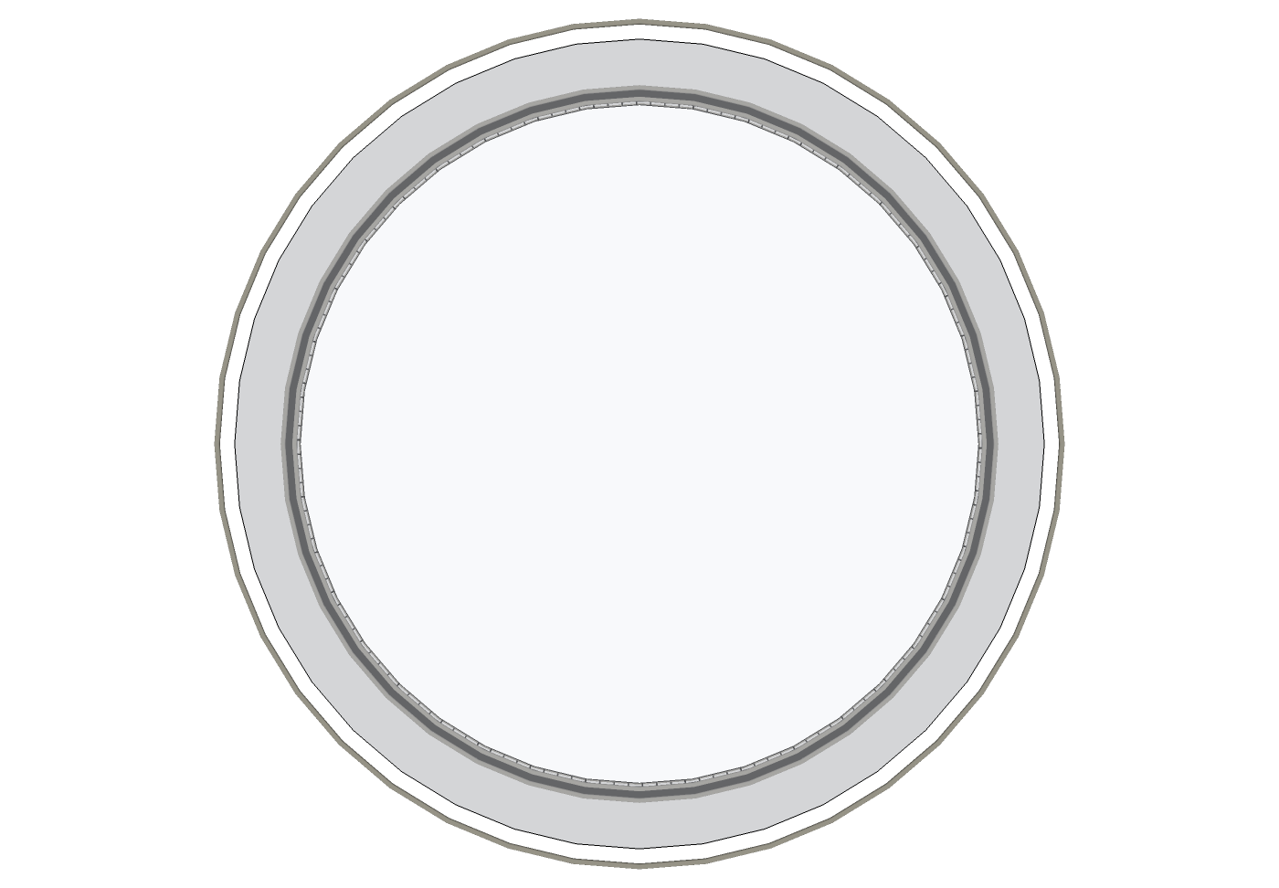
Top and bottom rings fish cage
Top ring
Bottom ring (8 tons)

